Slide 1

Module 5
Advanced Sensors
Position Encoders, Resonant Sensors, Sensors Based on Semiconductor Junctions, Fiber-Optic Sensors, Ultrasonic-Based Sensors, Biosensors, Superconducting Quantum Interference Devices (SQUIDs).
Text Book(s)
1. Winncy Y. Du, “Resistive, Capacitive, Inductive, and Magnetic Sensor Technologies”, 2019, 1st Edition, CRC press, London.
2. B. C. Nakra and K. K. Chaudhary, “Instrumentation, Measurement and Analysis”, 2016, 4th Edition, McGraw Hill Education India Private Limited.
Reference Books
3. Pethuru Raj and Anupama C. Raman, "The Internet of Things: Enabling Technologies, Platforms, and Use Cases", CRC Press, 2017.
4. Nihtianov, Stoyan, and Antonio Luque, eds. Smart sensors and MEMS: Intelligent sensing devices and microsystems for industrial applications. Woodhead Publishing, 2018.
5. R.S. Sedha-Electronic Measurement and Instrumentation-S Chand & Co Ltd (2013)

Slide 2
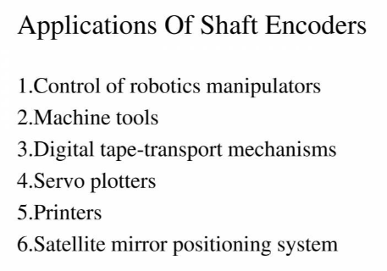
Position Encoders
An Encoder is a device, circuit, transducer, program, algorithm, etc that converts information from one format or code to another for the purpose of
standardization, speed, secrecy, security or saving space.
Its a device used to change a signal or data to a code.
Encoder is a digital optical device that converts motion into sequence of digital pulses.

Slide 3
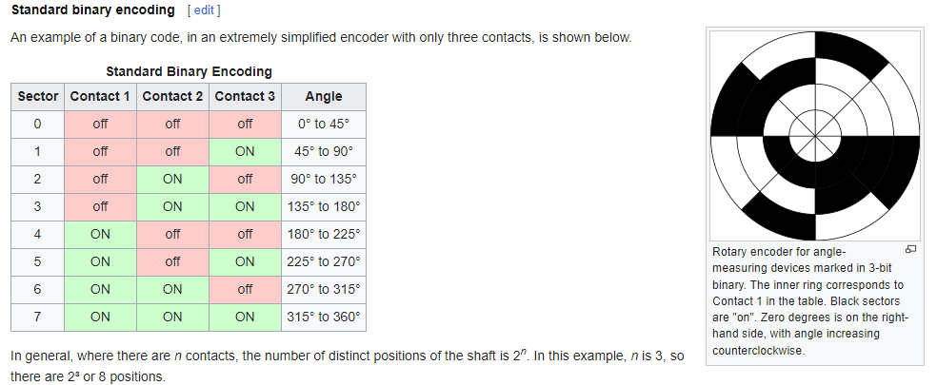
Encoder Types:
1. Absolute Encoder:
2. Incremental Encoder:
1. Absolute Encoder:
An absolute encoder maintains position information when power is removed from the encoder. The position of the encoder is available immediately on applying power. The relationship between the encoder value and the physical position of the controlled machinery is set at assembly; the system does not need to return to a calibration point to maintain position accuracy.
An absolute encoder has multiple code rings with various binary weightings which provide a data word representing the absolute position of the encoder within one revolution.

Slide 4
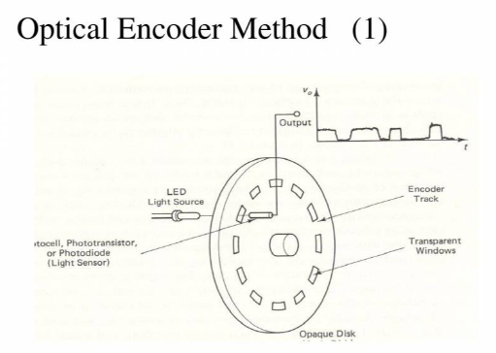
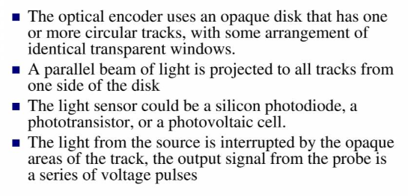
1. Optical Encoder Type-1

Slide 5
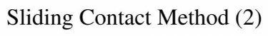
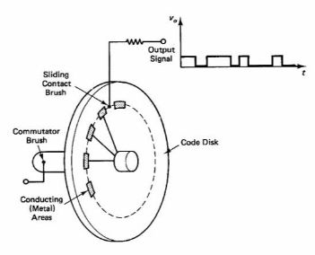
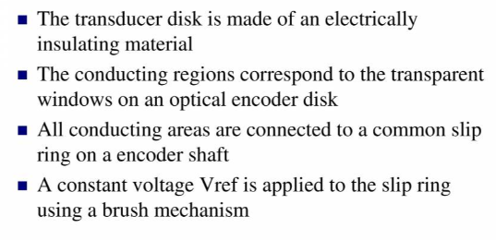

Slide 6
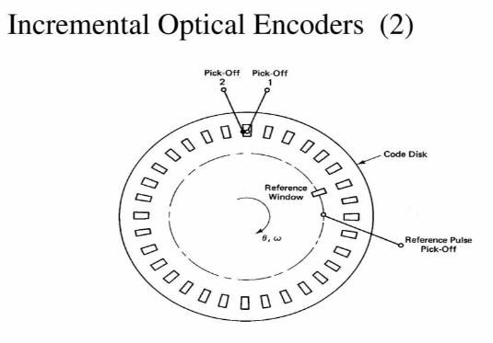
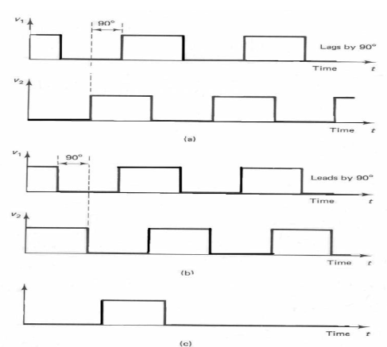
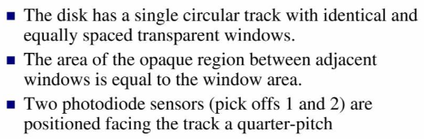
2. Incremental Encoder:
An incremental encoder will immediately report changes in position, which is an essential capability in some applications. However, it does not report or keep track of absolute position. As a result, the mechanical system monitored by an incremental encoder may have to be homed (moved to a fixed reference point) to initialize absolute position measurements.
clockwise
Anti -clockwise

Slide 7
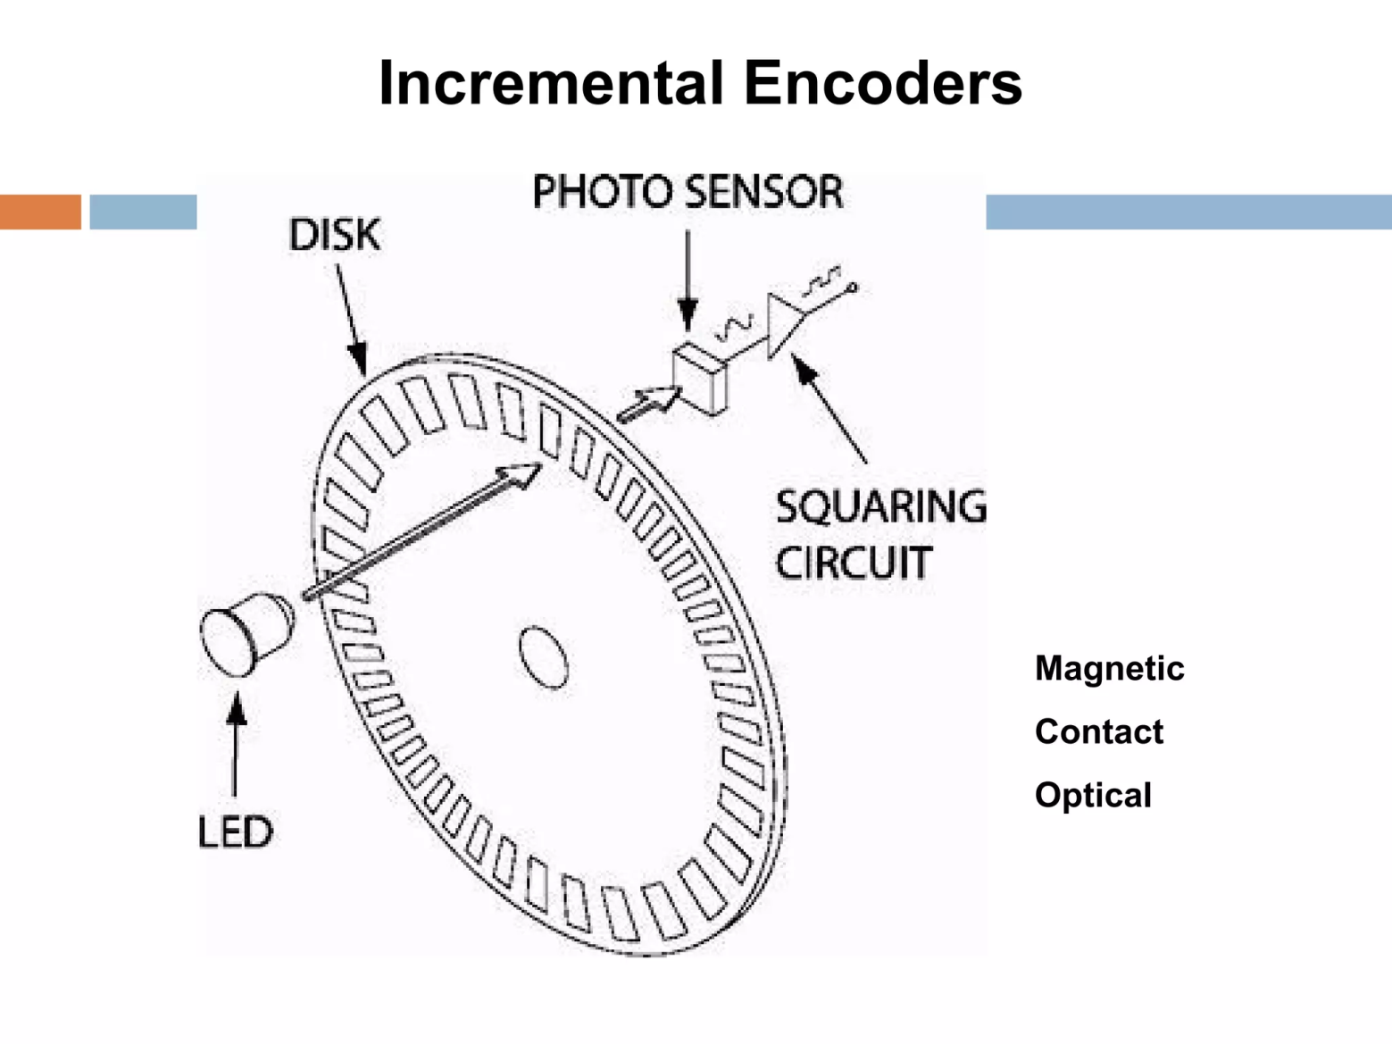

Slide 8
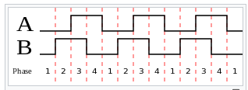
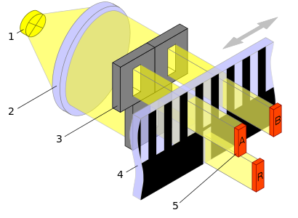
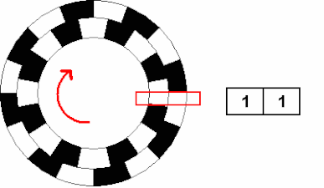
An incremental encoder employs a quadrature encoder to generate its A and B output signals.
The pulses emitted from the A and B outputs are quadrature-encoded, meaning that when the incremental encoder is moving at a constant velocity, the A and B waveforms are square waves and there is a 90 degree phase difference between A and B.
At any particular time, the phase difference between the A and B signals will be positive or negative depending on the encoder's direction of movement.
In the case of a rotary encoder, the phase difference is +90° for clockwise rotation and −90° for counter-clockwise rotation, or vice versa, depending on the device design.
The frequency of the pulses on the A or B output is directly proportional to the encoder's velocity (rate of position change); higher frequencies indicate rapid movement, whereas lower frequencies indicate slower speeds.
Static, unchanging signals are output on A and B when the encoder is motionless.
In the case of a rotary encoder, the frequency indicates the speed of the encoder's shaft rotation, and in linear encoders the frequency indicates the speed of linear traversal.
A
B
Rotary encoder, with corresponding A/B signal states shown on the right as the shaft reverses.
Linear encoder

Slide 9
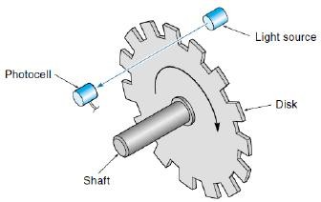
4. Optical Sensors: Shaft Encoders:
Encoders are electro-mechanical devices that convert the angular position or motion of a shaft or axle to an analog or digital code.
There are two main types: absolute and incremental (relative).
The output of absolute encoders indicates the current position of the shaft, making
them angle transducers.
It consists of a glass or plastic disc that rotates between a light source (LED) and a pair of photo-detectors
Disk is encoded with alternate light and dark sectors so pulses are produced as disk rotates.
When a disk with a pattern rotates, light passing through the slits is transmitted or blocked according to the pattern. The received light is converted to electrical currents in the detector elements, takes the form of waves, and becomes digital signals.

Slide 10
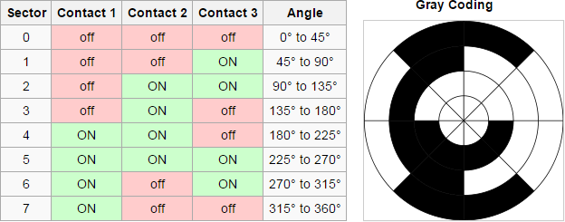
Absolute Encoders:
Absolute encoders have a unique code that can be detected for every angular position.
The optical absolute encoder's disc is made of glass or plastic with transparent and opaque areas. A light source and photo detector array reads the optical pattern that results from the disc's position at any one time.
They are available in the form of a “grey code”; a binary code of minimal change.
Absolute encoders are much more complex and expensive than incremental
encoders.
When to Use an Encoder:
Require accurate position
information:
10,000 line incremental
360 line absolute
Digital feed-back loop.
Compact and reasonably rugged.

Slide 11
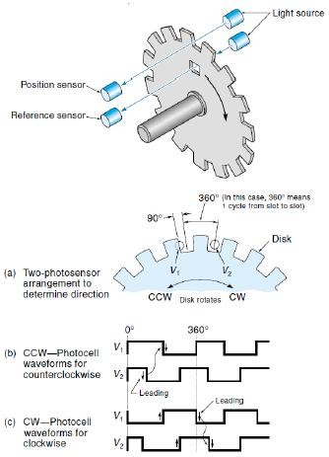
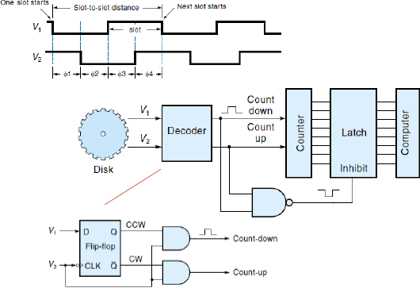
Example:

Slide 12
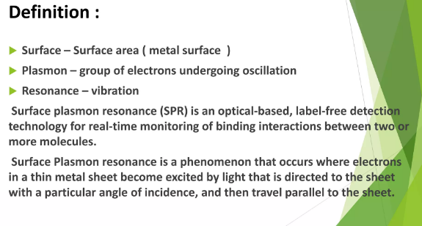
Resonant Sensors
Surface Plasmon Resonance
https://www.slideshare.net/HariniRaja4/surface-plasmon-resonance-sprpptx

Slide 13
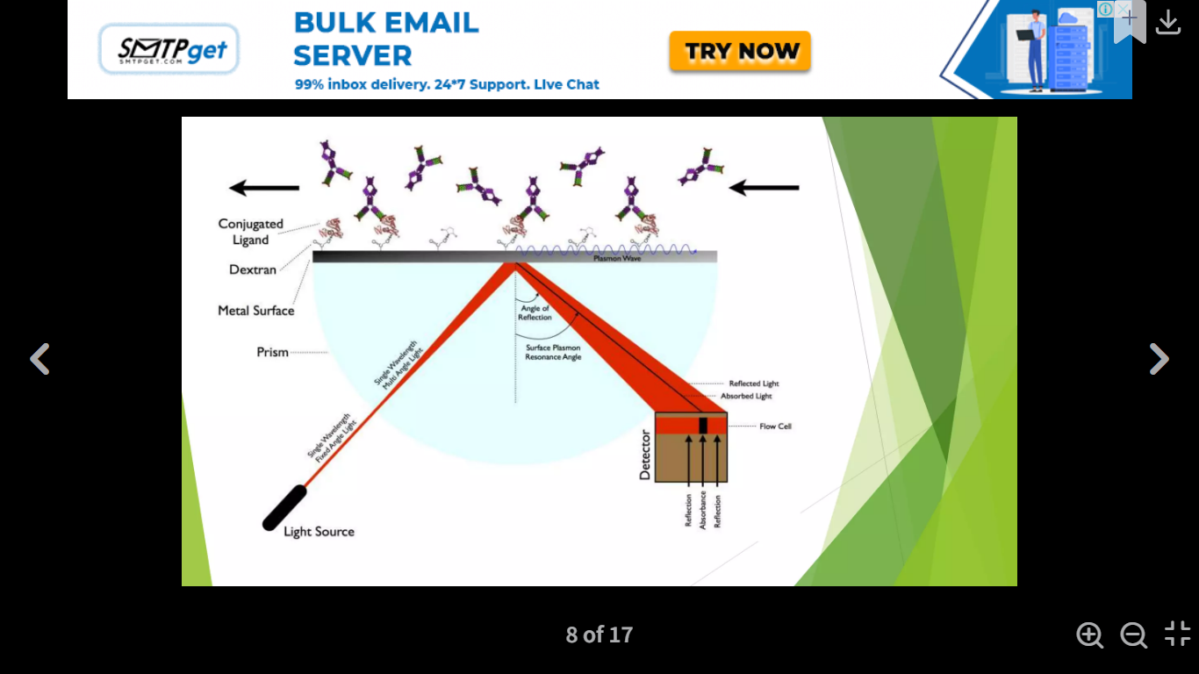
Principle : The SPR system consists of three core component,
The Sensor chip
Micro fluid system
SPR detection unit

Slide 14
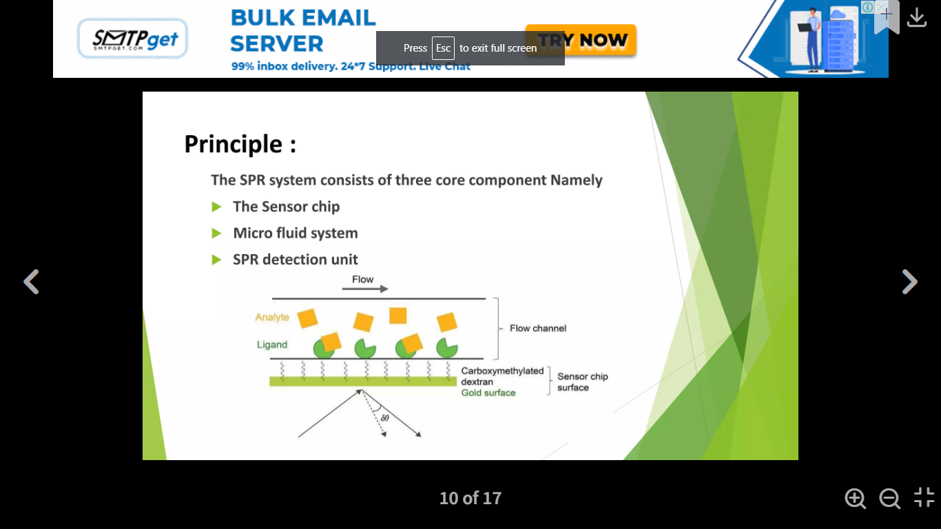
SPR Flow Diagram

Slide 15
The SPR-based binding method involves immobilization of a ligand on the surface of a sensor chip which has a monolayer of carboxy methylated dextran covalently attached to a gold surface. The ligand of interest is immobilized on the surface of the sensor chip using well-defined chemistry allowing solutions with different concentrations of an analyte to flow over it and to characterize its interactions to the immobilized ligand.
The SPR signal originates from changes in the refractive index at the surface of the gold sensor chip. The increase in mass associated with a binding event causes a proportional increase in the refractive index, which is observed as a change in response.
These changes are measured as changes in the resonance angle (δθ) of refracted light when the analyte, flowing in a microfluidic channel, binds to the immobilized ligand and increases in density at the sensor chip. Importantly, for protein-protein interactions the change in refractive index on the surface is linearly related to the number of molecules bound.
The response signal is quantified in resonance units (RU) and represents a shift in the resonance angle. When a steady-state is achieved (all binding sites occupied), the maximum RU is determined .

Slide 16
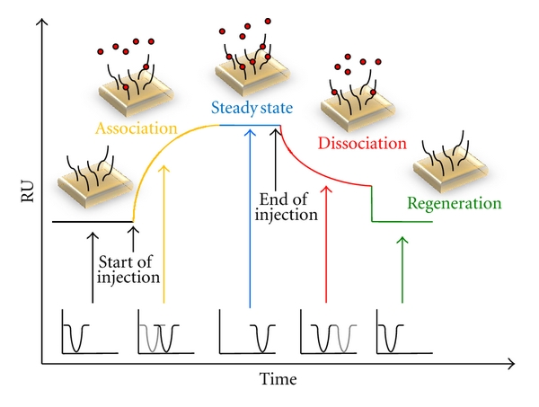
Monitoring the change in the SPR signal over time produces a sensorgram, a plot of the binding response (RU) versus time which allows different stages of a binding event to be visualized and evaluated.
During the injection of an analyte, the binding response increase is due to the formation of analyte–ligand complexes at the surface and the sensorgram is dominated by the association phase.
After a certain time of injection, a steady state is reached, in which binding and dissociating molecules are in equilibrium.
The decrease in response after analyte injection is terminated is due to dissociation of the complexes, defining the dissociation phase.
After the dissociation phase, the sensor becomes again ready for detection of a new type of molecules and is know as the regeneration phase.

Slide 17
Application of SPR:
SPR is a powerful label-free method widely used to study binding between two macromolecules .
SPR spectroscopy is mostly used in biosensing, especially when investigating binding affinities, such as antibody-antigen interactions.
Screening and developing new pharmaceuticals and new biotherapeutics
Quality control in bioprocess monitoring
Developing new diagnostic assays
Basic research such as discovering and characterizing protein function, disease mechanisms.

Slide 18
Sensors Based on Semiconductor Junctions
Thermo-resistive sensors
Resistance temperature detectors (RTD)
Thermistors
Thermoelectric sensors
Semiconductor p/n junction sensors
Optical temperature detectors
Pyrometers
Fiber optic detectors

Slide 19
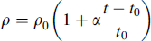
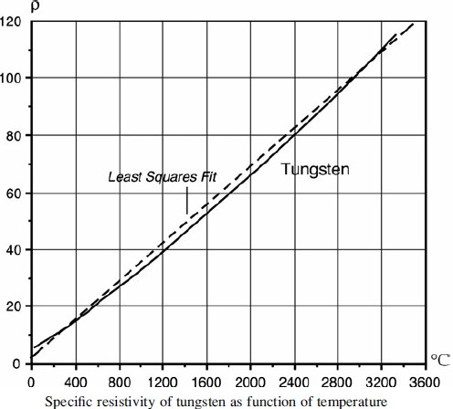
Resistance:Temperature Sensitivity:
Specific resistivity or conductivity of a material changes with temperature (t) and in a relatively narrow range may be linearly approximated through temperature coefficient of resistance (α);
where ρ₀ is the specific resistivity at reference temperature (t₀ ), commonly either 0 or
25 °C. In a broader range, resistivity is a nonlinear function of temperature.
Resistivity of tungsten may be modeled by a best fit straight line.
For a broader temperature range, tungsten
resistivity may be found from 2nd order equ.;
where t is temperature in °C and ρ is in Ω·m.

Slide 20
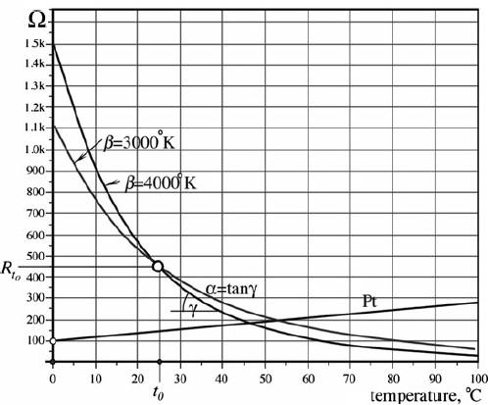
Temperature Sensors:
In sensor technologies, it is desirable to have a “bad” resistor whose temperature coefficient of resistivity (α) is high and predictable (α≥10⁻⁵).
A strong (α) allows to fabricate a temperature sensor known as a thermistor (thermal and resistor) and the Resistive Temperature Detector (RTD).
The most popular RTD is a platinum (Pt) temperature sensor, which operates over a
temperature range from about 200°C to over 600°C.
For a calibrating resistance R₀ at 0°C, use best fit straight line; equation;
For a better accuracy use a 2nd order polynomial which gives accuracy better than 0.01°C

Slide 21
Example:
If a Pt RTD sensor at a reference temperature 0°C has resistivity R₀=100 Ω, at +150°C; The linear approximation gives;
The 2nd order approximation gives;
The difference is 1.76 Ω, which is equivalent to an error at °150C of approximately
4.8C (nearly 3%).

Slide 22
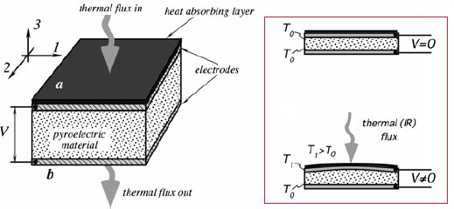
Pyroelectric Effect:
The pyroelectric effect is very closely related to the piezoelectric effect.
The pyroelectric materials are crystalline substances capable of generating an electrical charge in response to heat flow.
Like piezoelectrics, the pyroelectric materials are used in form of thin slices or films with electrodes deposited on the opposite sides to collect the thermally induced charges.
The pyroelectric sensor is essentially a capacitor, which can be electrically charged by flux of heat. The detector does not require any external electrical bias, it is a direct converter of heat into electricity. It needs only an appropriate electronic interface circuit to measure the charge.

Slide 23
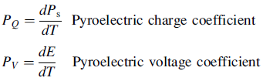
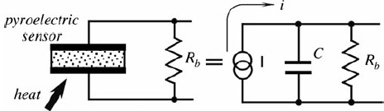
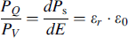
where;
P_{s} is the spontaneous polarization (electric charge),
E is the electric field strength, and T is the temperature.
Both coefficients are related by way of the electric permitivity (ε_{r}) and dielectric constant (ε₀);

Slide 24
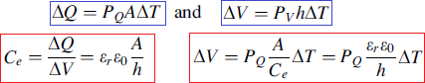
The pyroelectric sensor output signal is either charge (current) or voltage, depending on the application.
Being a capacitor, the pyroelectric device is discharged when connected to a resistor (R_{b}). Electric current through the resistor and voltage across the resistor represent the heat flow induced charge. It can be characterized by two pyroelectric coefficients
If a pyroelectric material is exposed to a heat source, its temperature rises by ΔT, then;
It is clear that the peak output voltage is proportional to the sensor’s temperature rise (ΔT) and pyroelectric charge coefficient (ε_{r} ε₀) and inversely proportional to its thickness (h).

Slide 25
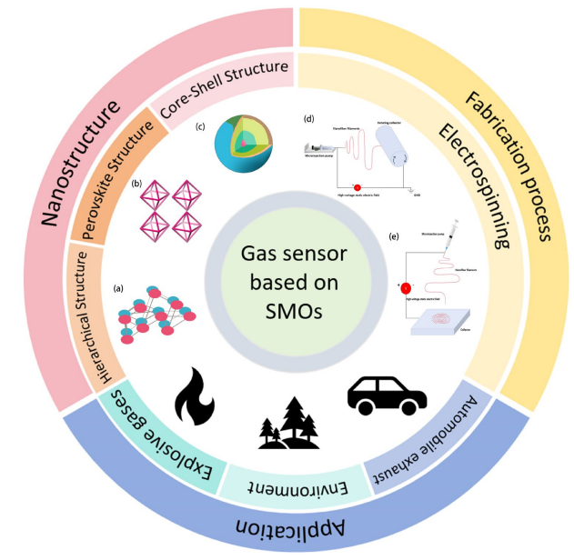
Sensors Based on Semiconductor Junctions

Slide 26
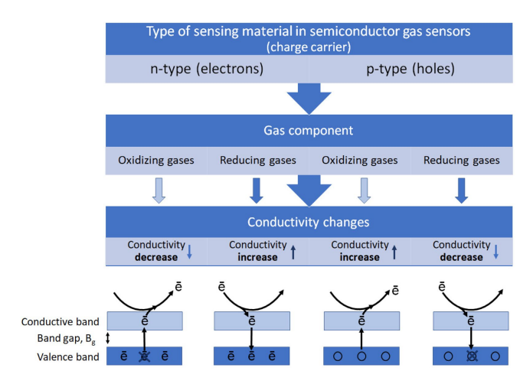
Sensors Based on Semiconductor Junctions

Slide 27
Sensors Based on Semiconductor Junctions
The gas sensitivity mechanism of SMOs closely relates to oxygen, a profound understanding of surface adsorption and catalytic oxidation processes is crucial.
Reaction mechanisms, thereby facilitating the advancement of novel gas-sensitive materials and doping strategies.
The gas sensitivity mechanism of SMOs is based on the oxygen adsorption model, which assumes that the change in resistance is related to the chemical adsorption of oxygen.
Upon exposure to air, oxygen molecules adsorb onto the surface of SMOs, forming chemisorbed oxygen (O2 −, O−, and O 2−) by capturing conduction band electrons.
The type of these oxygen species, which varies with the operational temperature and material type, plays a pivotal role in the gas-sensing performance.

Slide 28
Sensors Based on Semiconductor Junctions
The fundamental principles of the operation of gas sensors are shown in Figure. For both n-type and p-type SMO gas sensors, their operating principles depend on the type of majority carriers: electrons in n-type and holes in p-type semiconductors.
The sensing mechanism of n-type SMO gas sensors is explained below. In air, oxygen adsorbs on the sensor surface, captures electrons, and forms negative ions, increasing resistance due to a thicker electron depletion layer.
Exposure to reducing gases like ethanol or hydrogen reverses this effect by releasing the captured electrons, thinning the depletion layer, and lowering resistance.
Conversely, oxidizing gases like nitrogen dioxide enhance resistance by further depleting electrons

Slide 29
Sensors Based on Semiconductor Junctions
In addition, the selectivity mechanism of SMO gas sensors is primarily based on the material's ability to adsorb specific gas molecules and the resultant changes in electrical properties.
Different gases interact differently with the sensor's surface, influenced by factors like their grain size, porosity, operating temperatures, and the presence of dopants or modifiers.
In this context, nanomaterials play an essential role in the field of sensor technology due to their unique dimensional characteristics, significant surface-to-volume ratio, high porosity, and enhanced active sites, leading to increased gas adsorption.
Additionally, sensors prepared using different nanomaterials with adjustable sizes and surface functional groups have been reported to significantly enhance sensitivity and expand the range of target pollutants.
Nanomaterials are widely recognized for their excellent prospects in the development of advanced sensing technology. The nanomaterials used in these sensors are SMOs, modified SMOs, and nano composites SMOs.

Slide 30
Photo Diodes
A photo diode is a light sensitive device and it converts the illuminated light into electrical signal such as current.
Photodiodes are unique among light detectors in that when illuminated, they generate an output which is proportional to light level.
It is formed by placing a semiconductor PN junction in a sealed glass or plastic casing such that the radiations of light are allowed to fall on the surface across the junction when illuminated.

Slide 31
Photo diodes
Photo diodes are connected in reverse bias condition and when there is no illumination a small leakage current of the order of 1 µA flows across the junction. However when junction is properly illuminated, the current raises. This current is proportional to the intensity of light rays.
Photodiodes are based on the application of an inverse bias voltage, usually from 5 V to 30 V. This increases the width of the depletion region and yields a faster response time and a current proportional to the radiation intensity.

Slide 32
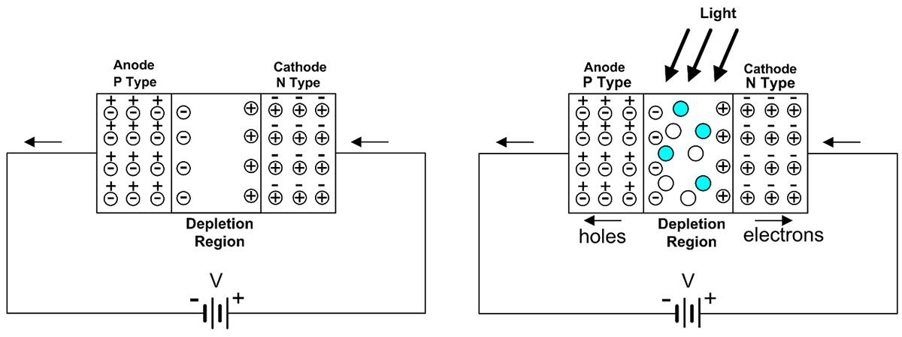

Slide 33
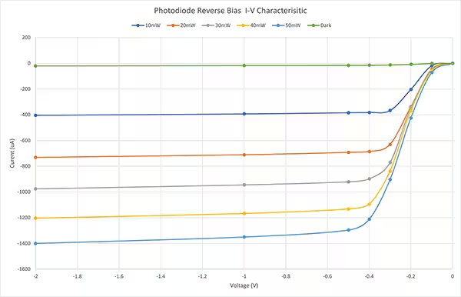

Slide 34
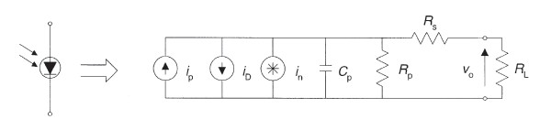
Equivalent circuit of Photodiode
Figure 9.5 shows Photodiode equivalent circuit. i_{p} is the signal current; i_{D} is the leakage current (dark current); i_{n} is the total noise current spectral density; R_{p} is the dynamic resistance; C_{p} is diode capacitance; R_{S} is the series resistance; R_{L} is the load resistance.

Slide 35
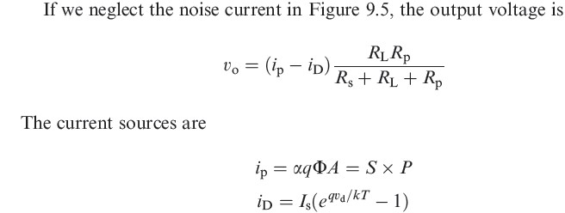
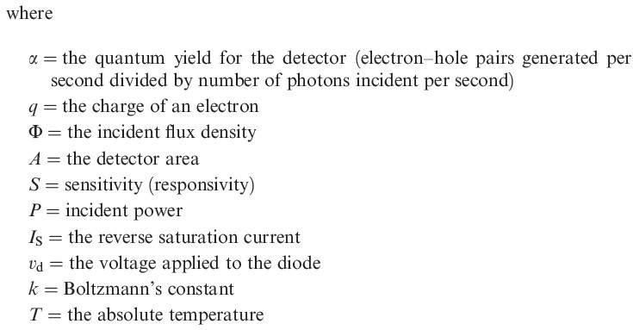

Slide 36
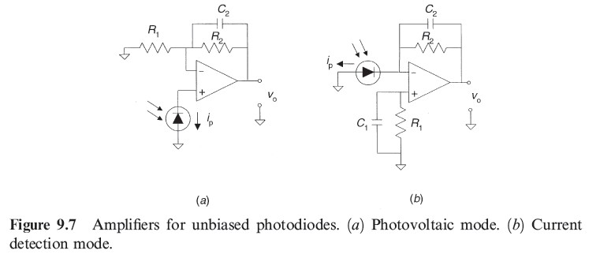
Signal Conditioners for photodiode

Slide 37
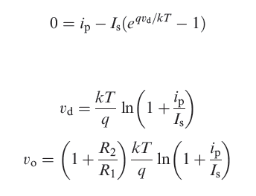
Figure 9.7 shows circuits for amplifying the output of an unbiased photodiode. In the photovoltaic mode we do not apply any bias and measure the open-circuit voltage (Figure 9.7a) or the short-circuit current by a transimpedance amplifier (Figure 9.7b). The absence of leakage current results in a very low noise, but the relatively high value for Cp due to the lack of applied reverse voltage reduces bandwidth. Since the op amp input current is negligible, the open-circuit output voltage v₀ when we measure voltage (Figure 9.7a) can be obtained from

Slide 38
Why Use Photodiodes?
Low cost visible and near-IR photodetector
Excellent linearity in output photocurrent over 7 to 9 decades of light intensity
Fast response times
Available in a wide range of packages including epoxy coated, transfer molded, cast, and hermetic packages as well as in chip form
Low noise
Mechanically rugged yet compact and lightweight
Dr.K.V.L.Narayana

Slide 39
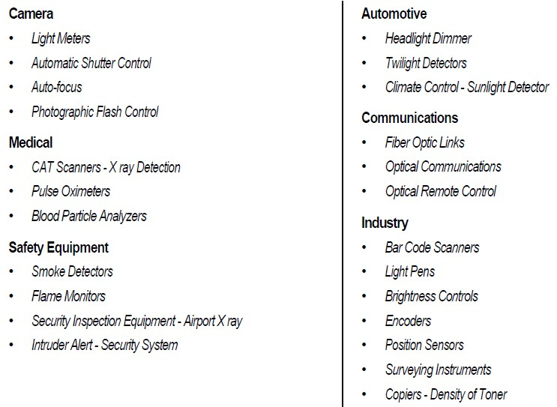
Applications of Photodiodes
Photodiodes are used different types of circuits and applications. Here are few examples

Slide 40
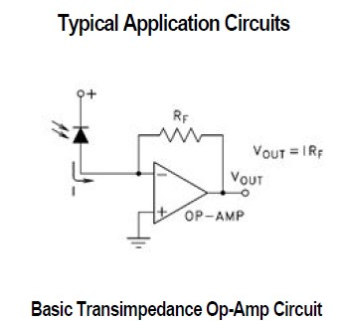
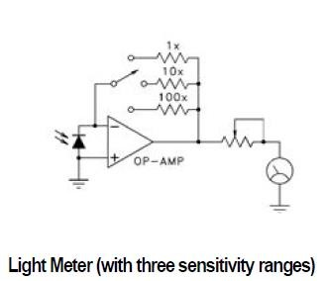
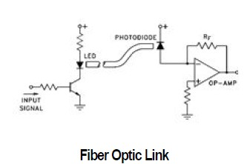
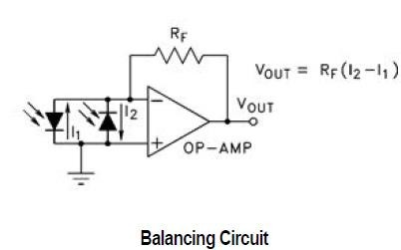
Photodiode Applications

Slide 41

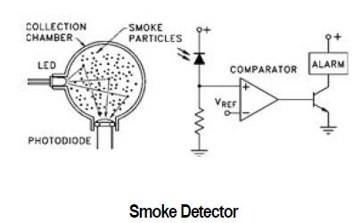
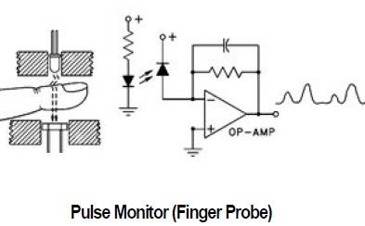
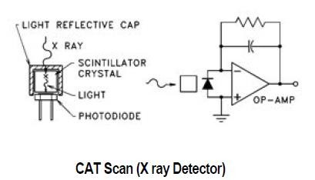

Slide 42
Photo Transistor
Photo transistor is normal transistor in which the envelope enclosing the junction is transparent to allow light to fall on the base-emitter junction.
At PN junction hole-electron pairs are generated when light falls on the junction, so that any light falling on the base-emitter junction produces a current which is amplified by transistor action, making the device is very sensitive.

Slide 43





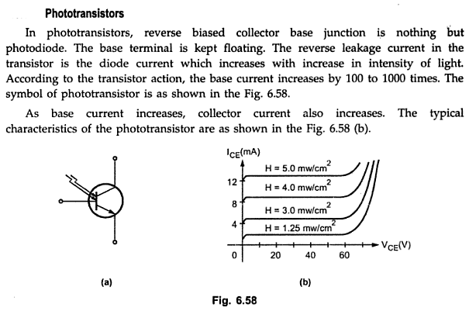

Slide 44
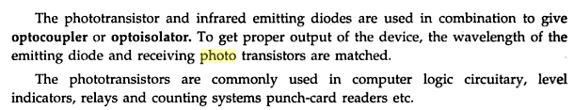
Photo Transistor

Slide 45
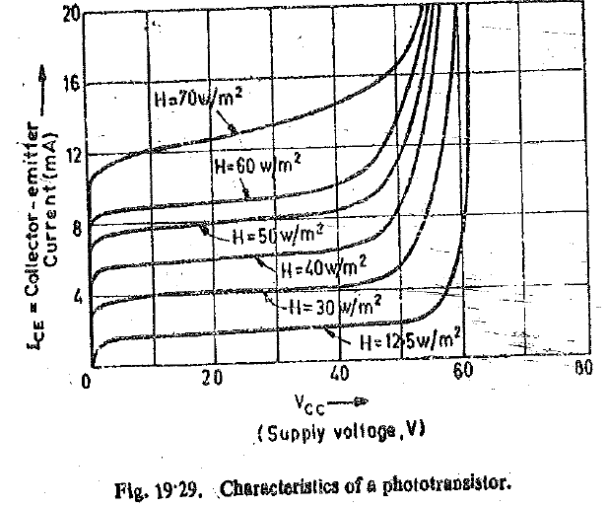
Characteristics of Photo Transistor

Slide 46
Advantages, Applications
Low Power Consumption
Small Size
Response time is more
Long life
Applications
A photo transistor gives a high gain. It is very good for digital applications because of small rise and fall times.

Slide 47
Ultrasonics Sensor Measurement of distance and displacement

Slide 48
ULTRASONIC RADAR
RADAR uses radio waves to detect the range, altitude, direction, or speed of objects.
Radars have been used for airport air-traffic control, highway patrol, ballistic missile guidance, military exercise and many other applications.
ULTRASONIC RADAR is an object-detection system which uses radio waves to determine the range, altitude, direction, or speed of objects.
Ultrasonic Radar systems are used for air-traffic control at airports, and long range surveillance and early-warning systems.
A radar system is the heart of a missile guidance system.
Radar was secretly developed by several nations before and during World War II.
The use of such technology has been seen recently in the self-parking car systems launched by Audi, Ford, and even the upcoming driverless cars by Google, Tesla,Volvo and BMW.

Slide 49

Ultrasonic waves
The Ultrasonic Sensor uses the speed that sound waves travels to measure distance to an object. The sensor has two openings on its front; one opening emits ultrasonic waves, while the other receives them.

Slide 50



Slide 51

How Does an Ultrasonic Sensor Work?
An ultrasonic sensor is a device that uses ultrasonic waves to measure an object’s distance.
Ultrasonic transducers
which are the microphone and speaker tandems
send and receive ultra-high frequency sound waves to obtain an object’s distance or proximity.
The ultra-high frequency sound waves are reflected from an object’s surface creating a unique echo pattern.

Slide 52

Ultra-high frequency sound waves being reflected from an object’s surface

Slide 53
HC-SR04 Ultrasonic Proximity Sensor
ultrasonic proximity sensors use high frequency sound signals to detect the presence of a target
ultrasonic proximity sensor that tells you whether an object is in front of it, and also provides the distance between the sensor and the object
sensing abilities make it particularly useful for robots that need to know how far they are away from an object or obstacle, for example, a wall or a piece of furniture that they shouldn’t hit

Slide 54

Principle of Operation
HC-SR04 gets triggered by a ten microsecond high signal on the trigger pin. Once it gets pulled low again, the module sends out eight 40kHz sound pulses.
If an object is present in the detection range, the sound pulses get reflected by that object, and the module receives the echo.
The time between sending the eight pulses and receiving the echo can be used to calculate the distance to the object that reflected the sound.

Slide 55

Characteristics of ultrasonic

Slide 56

Directivity

Slide 57

Directivity

Slide 58

False Reading

Slide 59

Applications

Slide 60
SQUID – Superconducting QUantum Interference Device
A superconductor is a material that can conduct electricity without any resistance when it is cooled below a certain critical temperature. This property makes superconductors extremely efficient at carrying electric current, as they lose no energy to heat, unlike normal conductors (such as copper or aluminum), which have some degree of electrical resistance.
Introduction
History
Operation
Applications

Slide 61
Introduction
Very sensitive magnetometer
Superconducting quantum interference device – based on quantum effects in superconducting loop
Useful for many purposes in physics, biology and medicine

Slide 62

History
●
1962: British physicist Brian David Josephson discovers Josephson effect, invents Josephson junction, SQUID
1973 Nobel Prize (with Leo Esaki and Ivar Giaever)
●
http://www.tcm.phy.cam.ac.uk/~bdj10/

Slide 63

Operation – Josephson effect
The Josephson effect occurs when an electric current (Cooper pairs) flows between two superconductors separated by a thin non- superconducting layer through quantum tunnelling.
Junction is called a Josephson junction.
Can only support a certain maximum (critical) current in a superconducting state.
http://www.albanet.com.mx/articulos/josephson.gif (modified)

Slide 64

Operation – Josephson junctions
●
Types of Josephson junctions:
Tunnel junctions, barrier is an oxide insulator
Semiconductor junctions
Dayem bridge junctions, based on a constriction.
Josephson junction
http://cr.physics.ed.ynu.ac.jp/labs/magne/shimazu/031101/results.html

Slide 65
Operation – Superconducting loop
A SQUID consists of a loop of superconductor with one or more Josephson junctions, called weak links.
Inner diameter of loop ~ 100 µm..
Generally made from either an alloy of lead and gold or indium, or pure niobium.
Ceramic superconductors such as yttrium-barium- copper-oxide also possible, but difficult to manufacture.

Slide 66
Topics
Superconductivity Definitions
SQUID
Principles
Applications

Slide 67
Superconductivity
Conduction lattice has zero resistance to currents through it
Usually occurs at lower temperatures
70K liquid nitrogen (cuprates, others)
~4K liquid ⁴helium (Niobium, lead, others)
Lattice vibrations decrease
Favorable lower energy states develop
Conduction mediators pair up (Copper pairs)
Pairs unite to form single conduction entity (cloud)
Currents Last forever (eg. MRI)

Slide 68
Superconductivity
Critical Temperature T_{c}
T_{c}
E
Not superconducting
Superconducting
0
T

Slide 69
Cooper pairs
Cooper pair is pair of individual conduction mediators that act as one unit (wave function, Ψ = Ψ₀e^{iθ}) due to interactions with the superconducting lattice
– electron-phonon interaction causes pairing leading to bosons occupying lower energy state
Can also happen with helium III and IV to form super-fluids which do not adhere to surfaces

Slide 70
Magnetic flux
Magnetic flux Φ is magnetic field B (= 𝛻 × 𝐴; A is magnetic potential; also = 𝛻 × (𝐴+ 𝛻Λ), ie gauge transform) multiplied by the area (S) that it covers thus its magnitude is arbitrary and continuous
Φ = ∫ 𝑩. 𝑑𝑺 or Φ = ф 𝑨. 𝑑𝒍

Slide 71
Quantum of Flux
Φ₀ is the quantum of flux that excites Cooper pairs to the next excited state (ie. same idea as excited state of hydrogen atom 21 centimeter line)
Φ₀ = h/(2e) ≈ 2.067833758(46)×10⁻¹⁵ Wb (T.m²)
h: Plank’s constant
e: charge of electron
Φ₀ is relatively large when expressed in T. mm²
~nanoT

Slide 72

Quantum Mechanical Tunneling
Particles, materials, objects cross barriers when classically forbidden
Tunneling changes amplitude and phase of Ψ
Tunneling coefficient
V₀
^{P}transmission
E
^{P}reflection
Phase change
X₁
X₂

Slide 73

Quantum Mechanical Tunneling
wiki

Slide 74

Measuring Magnetic Flux
Can use a magnetometer
wiki

Slide 75
Measuring Small Magnetic Flux
Add two thin resistors (Josephson junctions) into the superconducting loop to introduce tunneling

Slide 76
Measuring Small Magnetic Flux
Josephson junction introduces tunneling effect in the loop to allows the phase of the Cooper pair (cloud) to change with respect to itself while going around the loop leading to change in current amplitude due to interference
– think of it as a snake eating its own tail

Slide 77
Measuring Small Magnetic Flux
I_{net} = I/2 - I_{B}
I_{B}
I/2
I
I
V
I/2
I_{B}
B
I_{net}= I/2 + I_{B}

Slide 78
Measuring Small Magnetic Flux
The new total current due to external flux:
𝜈_{𝑎} − 𝜈_{𝑏}
𝑒 ℏ
𝐼 = 𝐼 𝑠𝑖𝑛
cos[
Φ]
𝑐
2
AC SQUID
𝑉 𝑡 =
ℏ 𝛛𝑣
2𝑒 𝛛𝑡

Slide 79



SQUID Gradiometer

Slide 80

Magnetic Fields of the Brain
Apical dendrite
Single neuron:
μ Q × r
Using a current dipole model: B = ⁰ ⋅
_{r}3
4π
Post-synaptic potential: Q~20 fA·m => B~20 pT @ 10 µm
Action potential: Q~100 fA·m => B~100 pT @10 µm
Cortex patch:
Cortex current ~100..250 nA/mm²; and
Active cortex area S ~ 50 mm² (R = 4 mm x h = 1 mm) The field:
Inside the cortex B~30 pT, outside the cortex (@ 30 mm) B~1 pT
Ref: Hämäläinen, M. et al, Rev Mod Phys, 65:413-497 (1993).

Slide 81

Operation – DC SQUID
Current made to flow around the loop through both Josephson junctions.
Electrons tunnel through the junctions, interfere.
Magnetic field through the loop causes a phase difference between electrons, affects current through the loop.
http://www.cmp.liv.ac.uk/frink/thesis/thesis/node47.html

Slide 82

Operation – DC SQUID
●
Flux (magnetic field) through the loop induces a current around the loop. This affects the current flowing through the loop, because the net current through each junction is no longer the same.
Resulting potential difference across the loop can be measured.
●
DC SQUID
http://cr.physics.ed.ynu.ac.jp/labs/magne/shimazu/031101/results.html

Slide 83
Operation – RF SQUID
Also called AC SQUID
Only one Josephson junction. Radio frequency oscillating current Measure interactions between the
superconducting ring and an external resonant LC circuit
– External inductor induces current in SQUID ring, and when the Josephson junction enters the resistive state it damps the LC circuit.

Slide 84
Operation – Interference
Background magnetic fields can be a problem.
Shielded room: expensive and cannot easily be moved.
Gradiometer measures gradient of field rather than absolute value. Interfering magnetic sources generally much further away, so vary less.
Measure ambient magnetic field and subtract from measurements.
Damping coils to cancel out the background field.
Johnson noise: magnetic field created by thermal motion of surrounding particles.

Slide 85
Applications
Biomagnetism
Scanning SQUID microscopy Geophysics
●
●
●

Slide 86
Applications – Biomagnetism
Processes in animals produce small magnetic fields (10⁻¹² – 10⁻⁹ tesla).
Fields associated with neural activity can be imaged by machines based on an array of SQUIDs, magnetoencephalography (MEG).
Generally use gradiometer DC SQUIDs.
Advantage: higher temporal resolution – images can be acquired in millisecond intervals, and respond rapidly to changes in neural activity. PET and MRI have a temporal resolution on the order of 1 second, higher spatial resolution.

Slide 87


Applications – Biomagnetism
Neuromag-122™
Neuromag Vectorview™
http://www.neuromag.com/products/122hw.html
http://www.neuromag.com/pdf/viivibrochyr_apr03_v4.pdf

Slide 88
Applications – Biomagnetism
●
SQUIDs can also be used to measure heartbeat; called a magnetocardiogram.

Slide 89


Applications – Scanning SQUID microscopy
●
By scanning a SQUID probe over a sample, a
high-resolution image of its magnetic field structure can
be obtained.
SQUID microscopy image of 1mm slice of Martian meteorite
http://www.gps.caltech.edu/tempfiles/magnetic_microscopy/
http://www.gps.caltech.edu/tempfiles/magnetic_microscopy/SQUIDmicro scope.jpg

Slide 90
Applications - Geophysics
●
Measure movement of the Earth's magnetic poles, variations in the thickness of the crust.
Oil prospecting, earthquake prediction, geothermal energy surveying.
Require portable containers with sufficient insulation to carry liquid helium.
– High temperature superconductors would help.
Methods of reducing magnetic noise needed.
●
●
●

Slide 91




Magnetoencephalography (MEG)

Slide 92

MEG
Bailett et al 2001

Slide 93

MEG
Sutherling, Akhtari, et al 2001

Slide 94

MEG
Sutherling, Akhtari, et al 2001

Slide 95

SQUID MRI
Matlachov et al 2008

Slide 96


Healthy person

Slide 97
Conclusions
SQUIDs are likely to be used increasingly in the future as they become cheaper and more versatile due to the development of high-temperature superconductors and better cooling systems.
●

Slide 98
Bio-Sensor
Modern day technological advances ensure analysis of almost every type of Biosecretion like enzymes, blood glucose, other biocatalysts, crude cell extract, viable plant cells etc. with the help of properly designed biprobe or nanoprobe.
Measurement of nonviable microbial cells or micro organisms or viable microbial cells is also possible with these types of biosensors.

Slide 99
Bio-Sensor
Biological Recognition Element (Bioreceptor):
This is a biological material that interacts with the analyte to produce a measurable signal. The bioreceptor is specific to the substance being measured and can be:
Enzymes: Catalyze a reaction with the analyte (e.g., glucose oxidase in glucose sensors).
Antibodies: Bind to specific antigens (e.g., for immunosensors).
DNA/RNA: Detect complementary nucleic acid sequences (e.g., for gene detection).
Cells: Used for detecting cell response or metabolic changes.
Tissues or Organelles: Can also be used for detection.

Slide 100
Bio-Sensor
Different types of biological materials are possible starting from enzyme, antibody organelle, hormones, nucleic acid or a whole cell which may be immobilized or mobilized.
Immobilized enzymes are prepared by soluble enzyme protein into a solid form of catalyst by different methods.
The immobilization technique is mainly developed due to reuse, or continuous use of the enzyme. The biosensor, with its tip coated with immobilized enzyme and fitted with a ion selective semi permeable membrane, is with intimate contact of the bio-material.
The biological signal produced is converted into electrical signal.

Slide 101
Bio-Sensor: Biocatalyst
Biocatalysts are special type of bio-product which accelerates reactions happening in Animal body.
The most prominent biocatalysts are enzymes. There are other types of biocatalyst like cell extract.
Plant and animal cell, viable microbial cells or micro organism and nonviable microbe cell.

Slide 102
Bio-Sensor: Enzymes
Enzymes
Commonly used animal enzymes are lipases, rennets, triprin etc. and plant enzymes are papain, analyses, soyabean lipoxy guase.
Enzymes are widely used in leather plant for softing of leather and detergent manufacturing. Enzymes are found in three methods
1. Due to natural secretion from cell i.e., extracellular secretion,
2. intracellular enzymes which remain in the cell, and
3. microbial enzyme which is prepared by the way of fermentation in presence of microorganism like bacteria virus or toxin. The production of primary and secondary metabolides is caused in presence of various enzymes.

Slide 103
Bio-Sensor: Enzymes
Enzymes are purified by preparation of concentrated solution by vacuum evaporation technique with low temperature.
It is also done by ultra filtration to remove stresses of microorganism.
The addition of preservative like calcium salt, protein starch, sugar as stabilizer is an important process.

Slide 104
Bio-Sensor: Enzymes
Production of Enzymes
The different methods used in the preparation of enzyme are
1. Isolate microorganism or development of strain
2. Culture medium formation and inoculum
3. Sterilization and inoculation of medium
4. Purification of enzyme
5. Immobilization

Slide 105
Bio-Sensor: Immobilization
Immobilization is a process in which enzyme has been separated from the bulk phase by some means.
Polymer has been created from the enzyme particularly for reuse of the enzyme product.
The bulk phase contains substrate, effector or inhibitor molecules in a dispersed way and by close monitoring, the enzyme as a polymer has been separated.
The pure enzyme may not be economical until they are prepared for reuse.
The immobilized enzyme is reused, not only that, they are useful for continuous use and needs less labour incentive.

Slide 106

Bio-Sensor: Immobilization
The different ways for immobilization are
Absorption
Covalent bonding
Entrapment
Encapsulation
Cross linking.

Slide 107
Bio-Sensor: Immobilization
The biological product when comes to intimate contact to a biological sensor, with immobilized layer, the sensor transduces biological signal to electrical sensor.
These immobilized layer sensor which analyse biological product like enzyme, hormone, antibody, nucleic acid, protein, organelle is called the biosensor.
There may be any type of electrode like ion-sensitive electrode, oxygen electrode, thermistor or photocell.

Slide 108
Bio-Sensor: Immobilization
The immobilized biological material in contact with the electrode polymer tip is fitted with a semi permeable membrane through which the biological material to be analysed, can pass and interact with immobilized bio-material on the sensor tip.
This interaction may produce gas, heat, electrons, oxygen, hydrogens ions and other ions.
The product passes through other membrane with specific permeability of the product to the sensor which either analyse the ionic activity or by thermistor to measure temperature or oxygen ion concentration to produce an electrical signal which is recorded.

Slide 109

Bio-Sensor: Glucose Electrode
The glucose electrode shown in Fig. is separated from immobilized glucose oxydase solution with a semipermeable membrane of cellulose acetate with specific permeability for glucose ion and oxygen.

Slide 110
Bio-Sensor: Glucose Electrode
The glucose and oxygen penetrate through the membrane and the reaction with immobilized glucose oxydase produces water, gluconic acid, hydrogen peroxide, water, oxygen and glucose oxide. In this way oxygen concentration in the gel is low. This
oxygen concentration has been sensed by the oxygen electrode in potassium chloride solution. Electrode records the rate of oxidation reduction reaction and the rate of decrease in oxygen level is directly proportional to the concentration of glucose in the
solution. The range of glucose concentration in which this biosensor is applicable is 10^-1 - 10^-5 mol dm ^- 5, with a response time of 1.5 minutes.

Slide 111

Bio-Sensor: Glucose Electrode
Electro-chemical biosensors, Field effect transistor or light emitting diodes are present which transfer the charge layer produced by reaction between bio-materialand its specific enzyme to current or optics. As field effect transistor provides high input impedance and low output impedance it is used to pick the low e.m.f. produced, and amplify it. The second from of biosensor is of amperometric type which analyse reaction between bio material with corresponding enzyme so that electron has been generated directly or through a mediator.

Slide 112

Bio-Sensor: Glucose Electrode
In enzymes' electrode, the substrate which may be protein, amino acid, glucose, alcohol or lactic acid, reacts with a enzyme separated by thin permeable membrane.
The reaction produce O2, hydrogen ion, Ammonium ion, carbon dioxide or small molecules due to enzyme reaction.
The potentiometric response from the electrode depends on the concentration of the substrate.

Slide 113

Bio-Sensor: Glucose Electrode

Slide 114
Bio-Sensor: Glucose Electrode
Colour changes due to biosensing:
In these biosensor there is a coating of enzymes or antibodies on the membrane. The biosensor is also coated with dye on the membrane. The substrate reacts with enzyme or antibody and due to change in pH level of the yield there is a colour change is the dye-membrane coating. These changes in the colour of dye is sensed by light emitting diode.

Slide 115
Bio-Sensor: Glucose Electrode
Use of biosensors.
Biosensors have following applications in medicine, industry, pollution control, detergent industry etc.
Glucose analysers are used to find the concentration of blood glucose level and the amount of insulin required.
Detection of Mitomycin and aflatoxin, which causes cancer in infants may be detected by biosensors.
The quality control of drinking water has been performed by monitoring with biosensors i.e., measuring BOD (oxygen demand).
A microbial cell biosensor is used to detect the mutagenecity and carcinogenedty of some compounds. Biosensors are used in fermentation control to derive different industrial product.

